Slide 1
CSDS 497: AI: Statistical Natural Language Processing
Sarah Yurick (sey13@case.edu)
Office: Zoomlandia 955 9565 1270 / 406488
Office Hours: F 12-2 or by appointment
Please ensure your full name is visible on zoom.
Check that your mic is connected by looking for the mic symbol next to your name in the Participants list. If not you can configure your mic and speakers using arrow next to the mic button in the lower left of the zoom interface.
You will be muted on entry (mic symbol has a line through it). Unmute to ask/answer questions.
Leave your mic on mute and video off until you are speaking.
To ask a question, use “Raise Hand” and wait to be called or send your question via chat.
To answer a question, use “Raise Hand” and wait to be called.
After asking or answering your question, click “Raise Hand” again to lower your hand.
This meeting is being recorded. The recording will be made available, likely via canvas.
If I drop out/can’t be heard/screen freezes/slides disappear etc, please send a note in the chat window.
If I get disconnected completely, I will rejoin asap. Please be patient and wait. If there is a serious issue and I cannot rejoin, I will send email and the class will be postponed.
11/10/2020 Sarah Yurick, Case Western Reserve U. 1
Notes:
Meeting ID: 955 9565 1270
Passcode: 406488

Slide 2
Recap
Distributional semantics is a research area that develops and studies theories and methods quantifying and categorizing s_______ similarities between linguistic items based on their d_____________ properties in large samples of language data.
11/10/2020 Sarah Yurick, Case Western Reserve U. 2

Slide 3
Today
word2vec (CBOW and SG)
GloVe
11/10/2020 Sarah Yurick, Case Western Reserve U. 3

Slide 4
Representing words
One-Hot Encoding (Count Vectorizing)
vector(“King”) = [ 0, 0, 0, …, 0, 1, 0, …, 0, 0 ]
A vector of length n << V
vector(“King”) = [ 0.083, 0.079, 0.011 ]
11/10/2020 Sarah Yurick, Case Western Reserve U. 4
Notes:
A matrix?

Slide 5
Creating meaning
Similar words should be close to each other
Words can have multiple degrees of similarity
Beyond simple syntactic regularities
11/10/2020 Sarah Yurick, Case Western Reserve U. 5

Slide 6
word2vec
Preserve the linear regularities among words
Use neural networks for learning
All models are trained using stochastic gradient descent and backpropagation
11/10/2020 Sarah Yurick, Case Western Reserve U. 6

Slide 7
Continuous Bag-of-Words (CBOW)
Predict a word given its context
“Sarah received an A on her presentation.”
{
{
Context
Context
Word we are predicting
11/10/2020 Sarah Yurick, Case Western Reserve U. 7

Slide 8
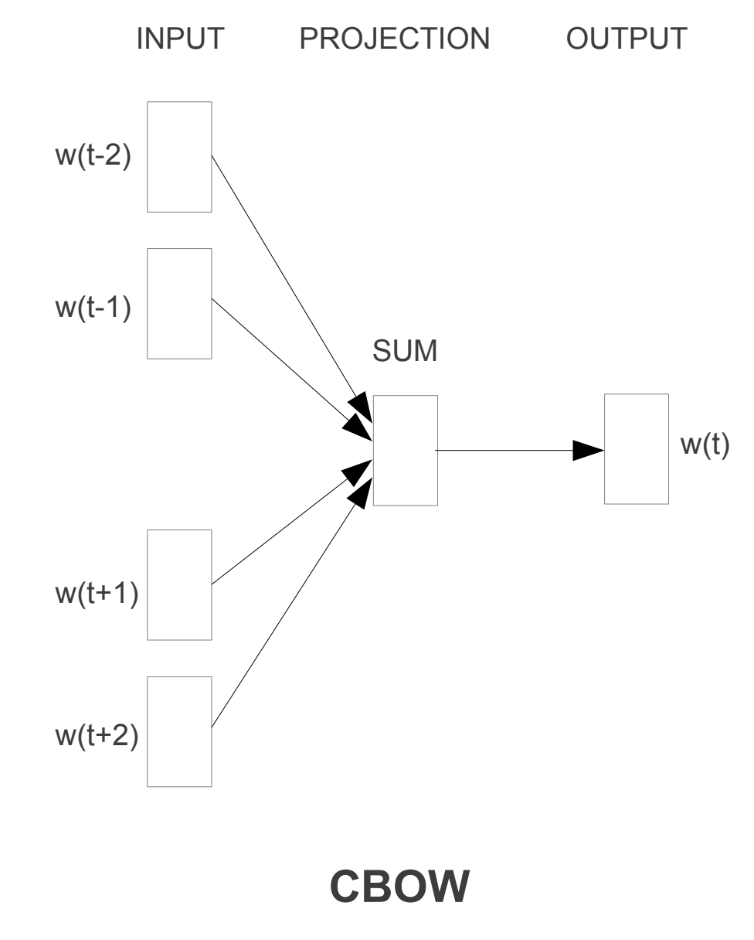
Continuous Bag-of-Words
c=2

Slide 9
Continuous Skip-gram
Predict words within a certain range before and after the current word
“Sarah received an A on her presentation.”
{
{
Predicted context
Predicted context
Input word
11/10/2020 Sarah Yurick, Case Western Reserve U. 9

Slide 10
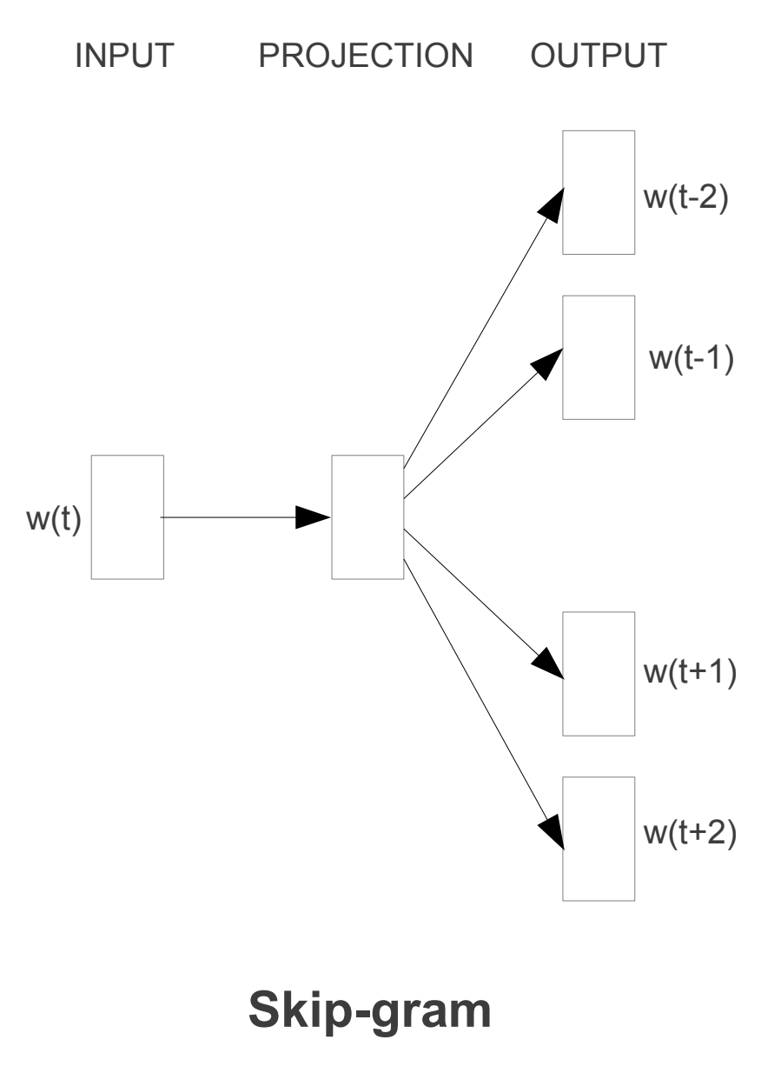
Continuous SG
c=2

Slide 11
Skip-gram
Since the more distant words are usually less related to the current word than those close to it, we give less weight to the distant words by sampling less from those words in our training examples
If we choose C=5, for each training word we will select randomly a number R in range <1; C>
11/10/2020 Sarah Yurick, Case Western Reserve U. 11

Slide 12

Training objective
Maximize the average log probability:
c is the size of the training context
w_{t} is the center word
11/10/2020 Sarah Yurick, Case Western Reserve U. 12
Notes:
\frac{1}{T}\sum_{t=1}^T\sum_{-c\leq j\leq c, j\ne0} log p(w_{t+j}|w_t)

Slide 13


Hierarchical Softmax
v and v’ = the input and output vectors
n(w,j) = the j-th node on the path from the root to w
L(w) = the length of this path
ch(n) = an arbitrary fixed child of n
[[x]] = 1 if x is true, -1 otherwise
σ(x) = 1/(1+exp(-x))
Full softmax
11/10/2020 Sarah Yurick, Case Western Reserve U. 13
Notes:
n(w,1) = root
n(w,L(w)) = w

Slide 14

Negative Sampling
Task is to distinguish the target word w_{O} from draws from the noise distribution P_{n}(w) using logistic regression, where there are k negative samples for each data sample
To replace every log P(w_{O}|w_{I}) term in the Skip-gram objective:
11/10/2020 Sarah Yurick, Case Western Reserve U. 14

Slide 15

Subsampling of Frequent Words
“France” and “Paris” versus “France” and “the”
The vector representations of frequent words do not change significantly after training on several million examples
Each word w_{i} in the training set is discarded with probability:
11/10/2020 Sarah Yurick, Case Western Reserve U. 15

Slide 16

Learning Phrases
Unigram and bigram counts!
Discounting coefficient to prevent too many phrases consisting of very infrequent words to be formed
Run 2-4 passes over the training data with decreasing threshold value, allowing longer phrases that consist of several words to be formed
11/10/2020 Sarah Yurick, Case Western Reserve U. 16

Slide 17
Additive Compositionality
vector(“King”) - vector(“Man”) + vector(“Woman”)
vector(“biggest”) - vector(“big”) + vector(“small”)
vector(“Paris”) - vector(“France”) + vector(“Italy”)
11/10/2020 Sarah Yurick, Case Western Reserve U. 17
Notes:
Another way to improve accuracy is to provide more than one example of the relationship - by using ten examples instead of one to form the relationship vector (we average the individual vectors together), we have observed improvement of accuracy of our best models by about 10% absolutely on the semantic-syntactic test

Slide 18
Comparisons
CBOW training < Skip-gram training
Skip-gram performance > CBOW performance
11/10/2020 Sarah Yurick, Case Western Reserve U. 18

Slide 19
Global Vectors (GloVe)
Global matrix factorization
Count-based
Co-occurrence matrix
Efficiently leverages statistical information
Disproportionality (ex: co-occurring with “the”)
Local context window methods
Poorly utilize the statistics of the corpus
11/10/2020 Sarah Yurick, Case Western Reserve U. 19

Slide 20
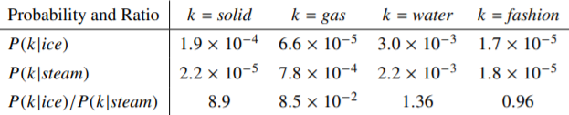
Intuition
We have our co-occurrence matrix
11/10/2020 Sarah Yurick, Case Western Reserve U. 20

Slide 21




Cost function
Co-occurrence matrix X
X_{ik} = how often word i appears with word k
X_{i} = how often word i appears
11/10/2020 Sarah Yurick, Case Western Reserve U. 21

Slide 22
GloVe summary
Generates W (and Ŵ)
Fast training
GloVe performance > word2vec performance
A lot of memory
11/10/2020 Sarah Yurick, Case Western Reserve U. 22

